Slide 1
Control Statements: Part 3; Logical Operators
Chapter 5 of C++ How to Program, 10/e

Slide 2
5.9 switch Multiple-Selection Statement
The switch multiple-selection statement performs many different actions based on the possible values of a variable or expression.
Each action is associated with the value of an integral constant expression (i.e., any combination of character and integer constants that evaluates to a constant integer value).
Figure 5.11 calculates the class average of a set of numeric grades entered by the user, and uses a switch statement to determine whether each grade is the equivalent of an A, B, C, D or F and to increment the appropriate grade counter.

Slide 3
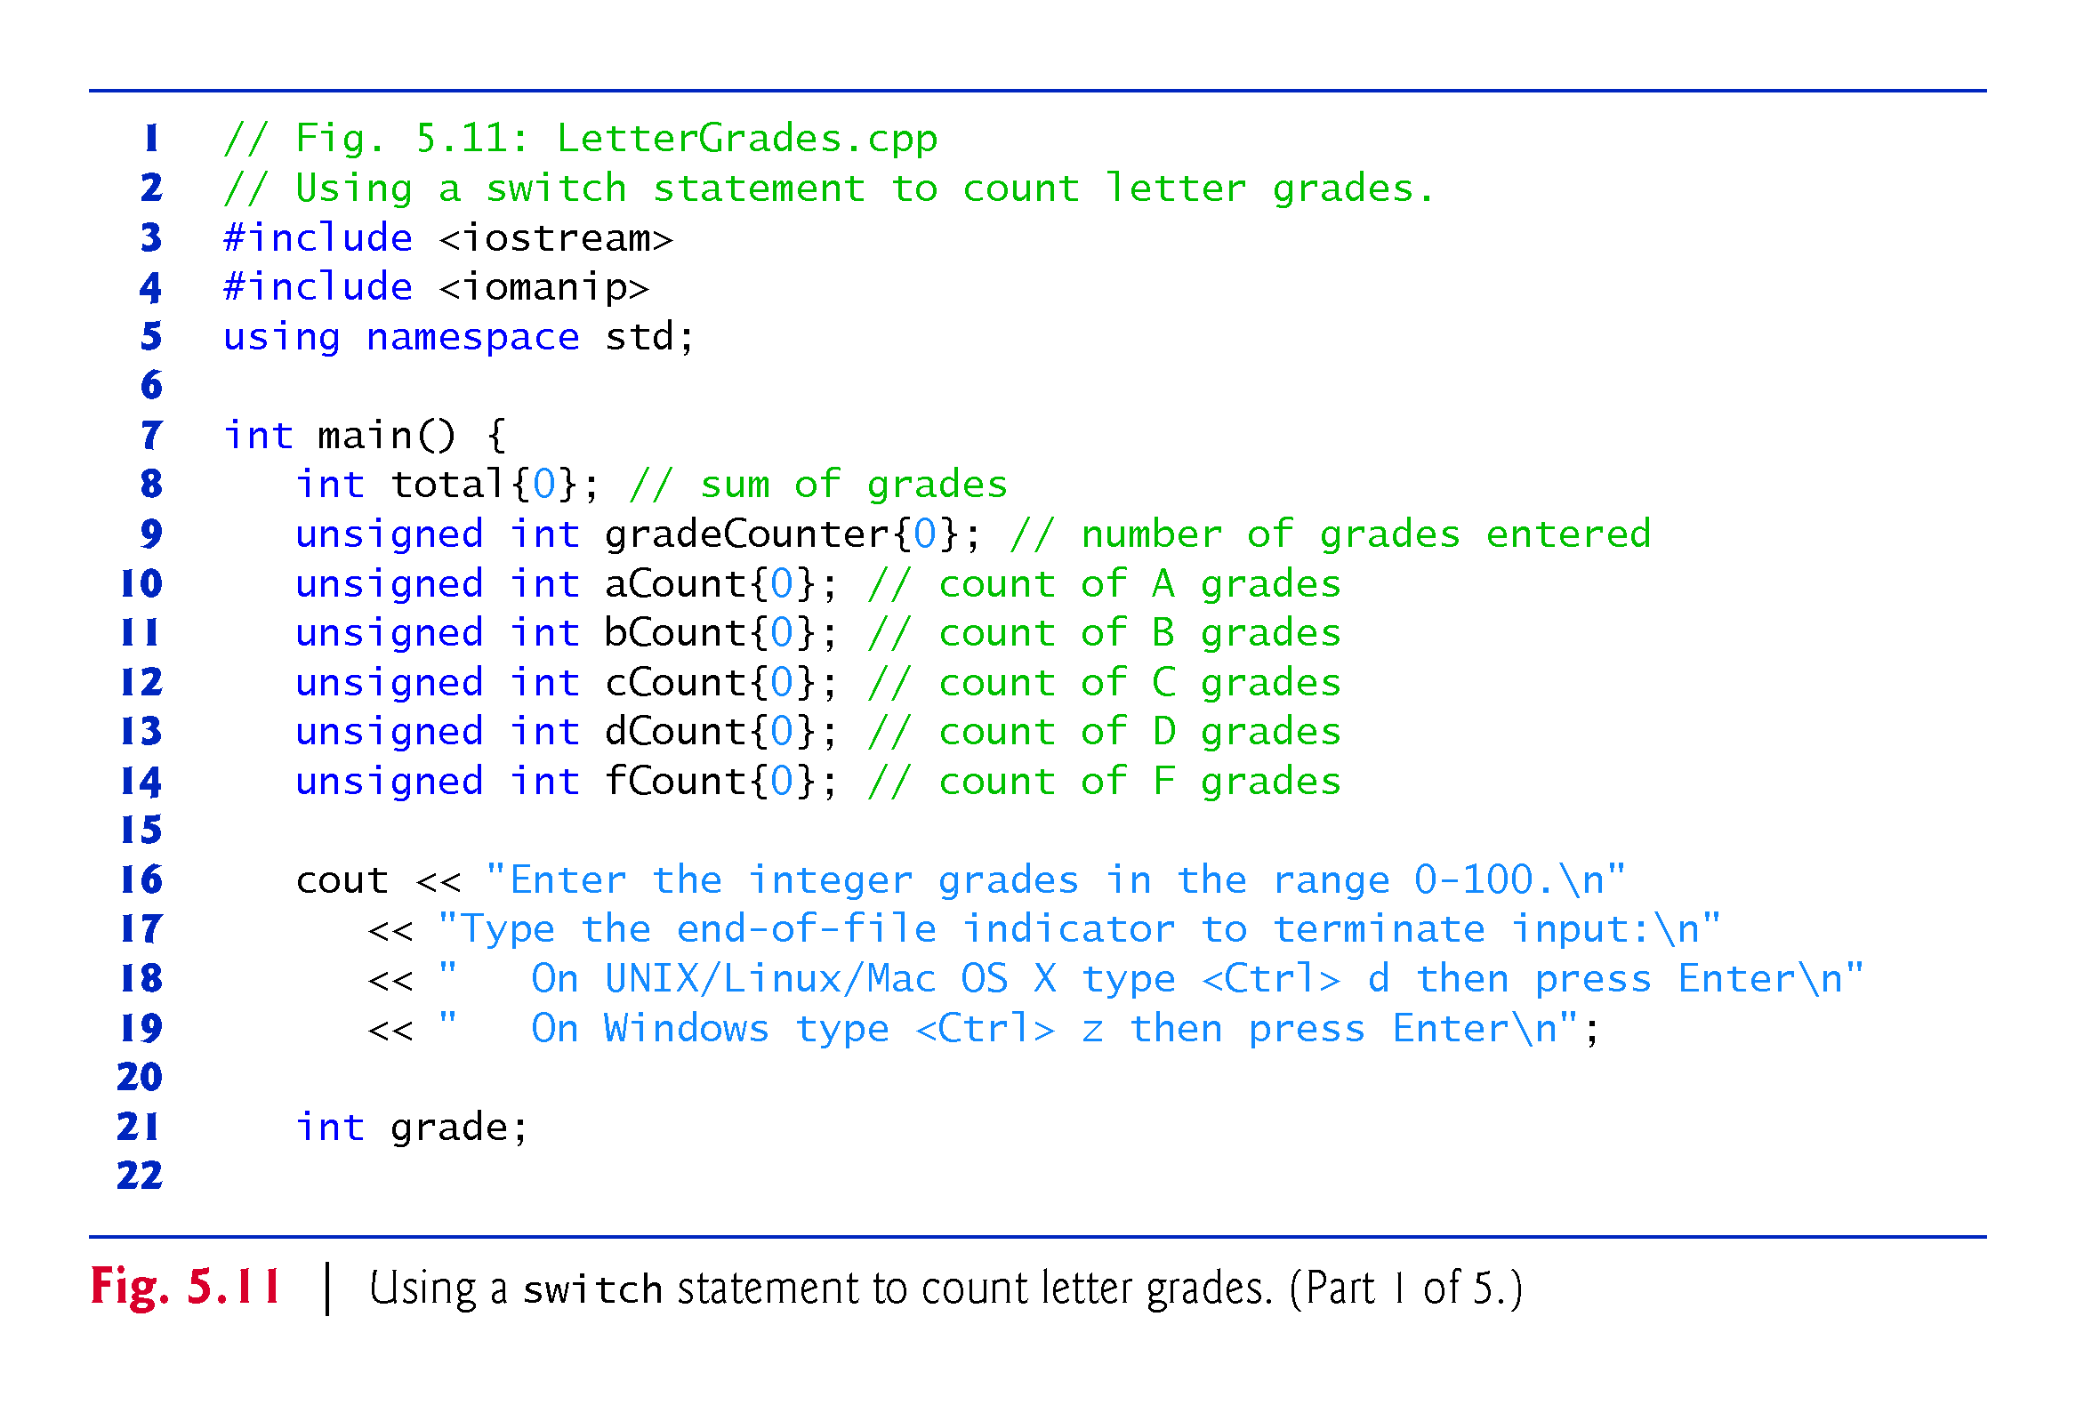

Slide 4
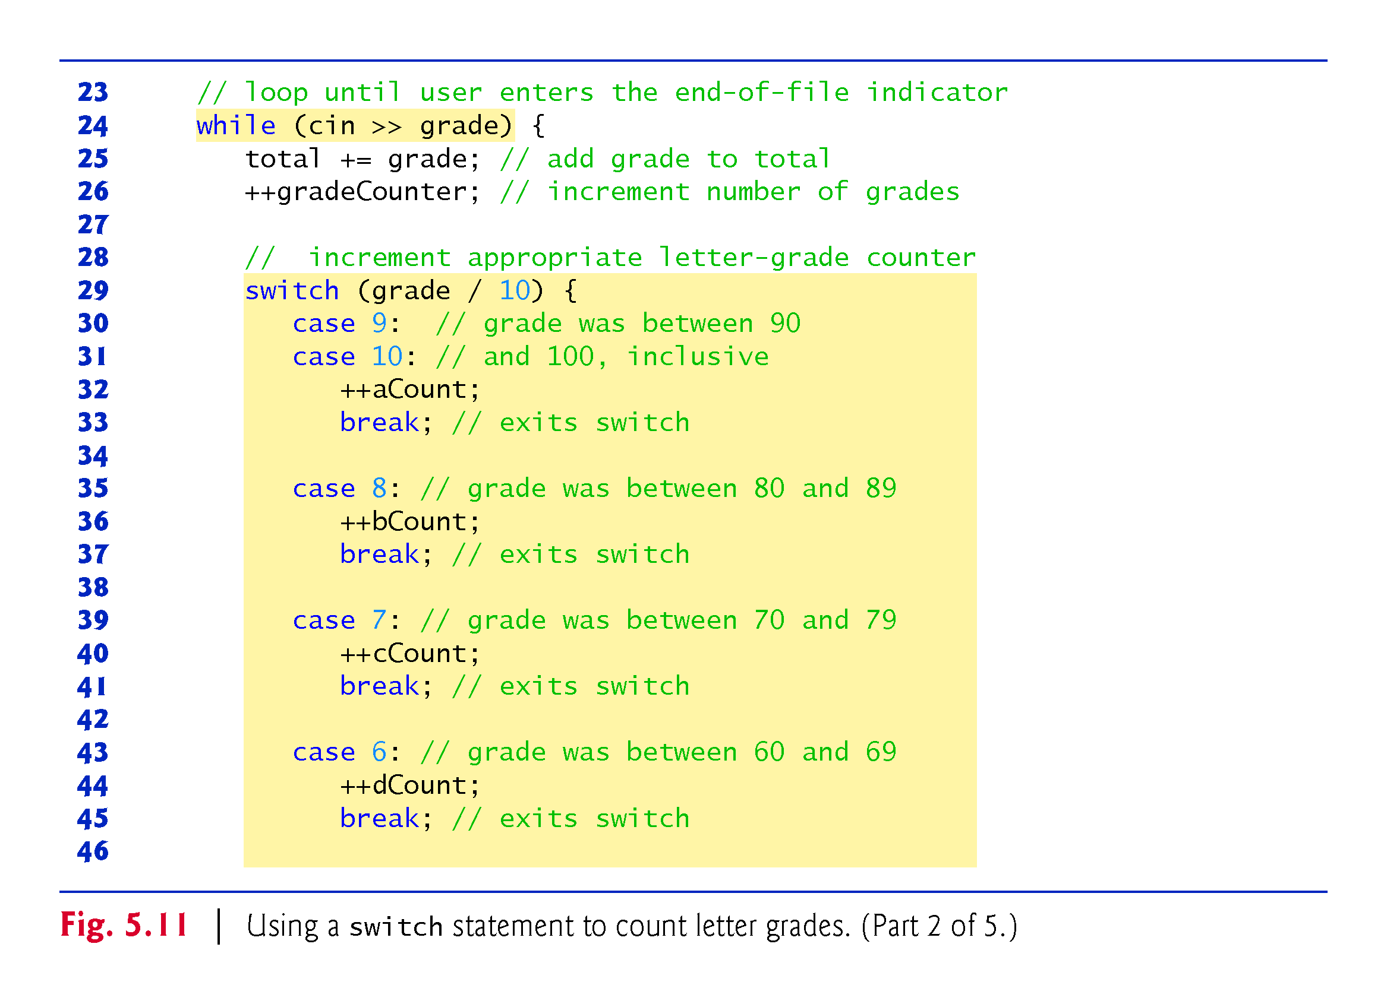

Slide 5
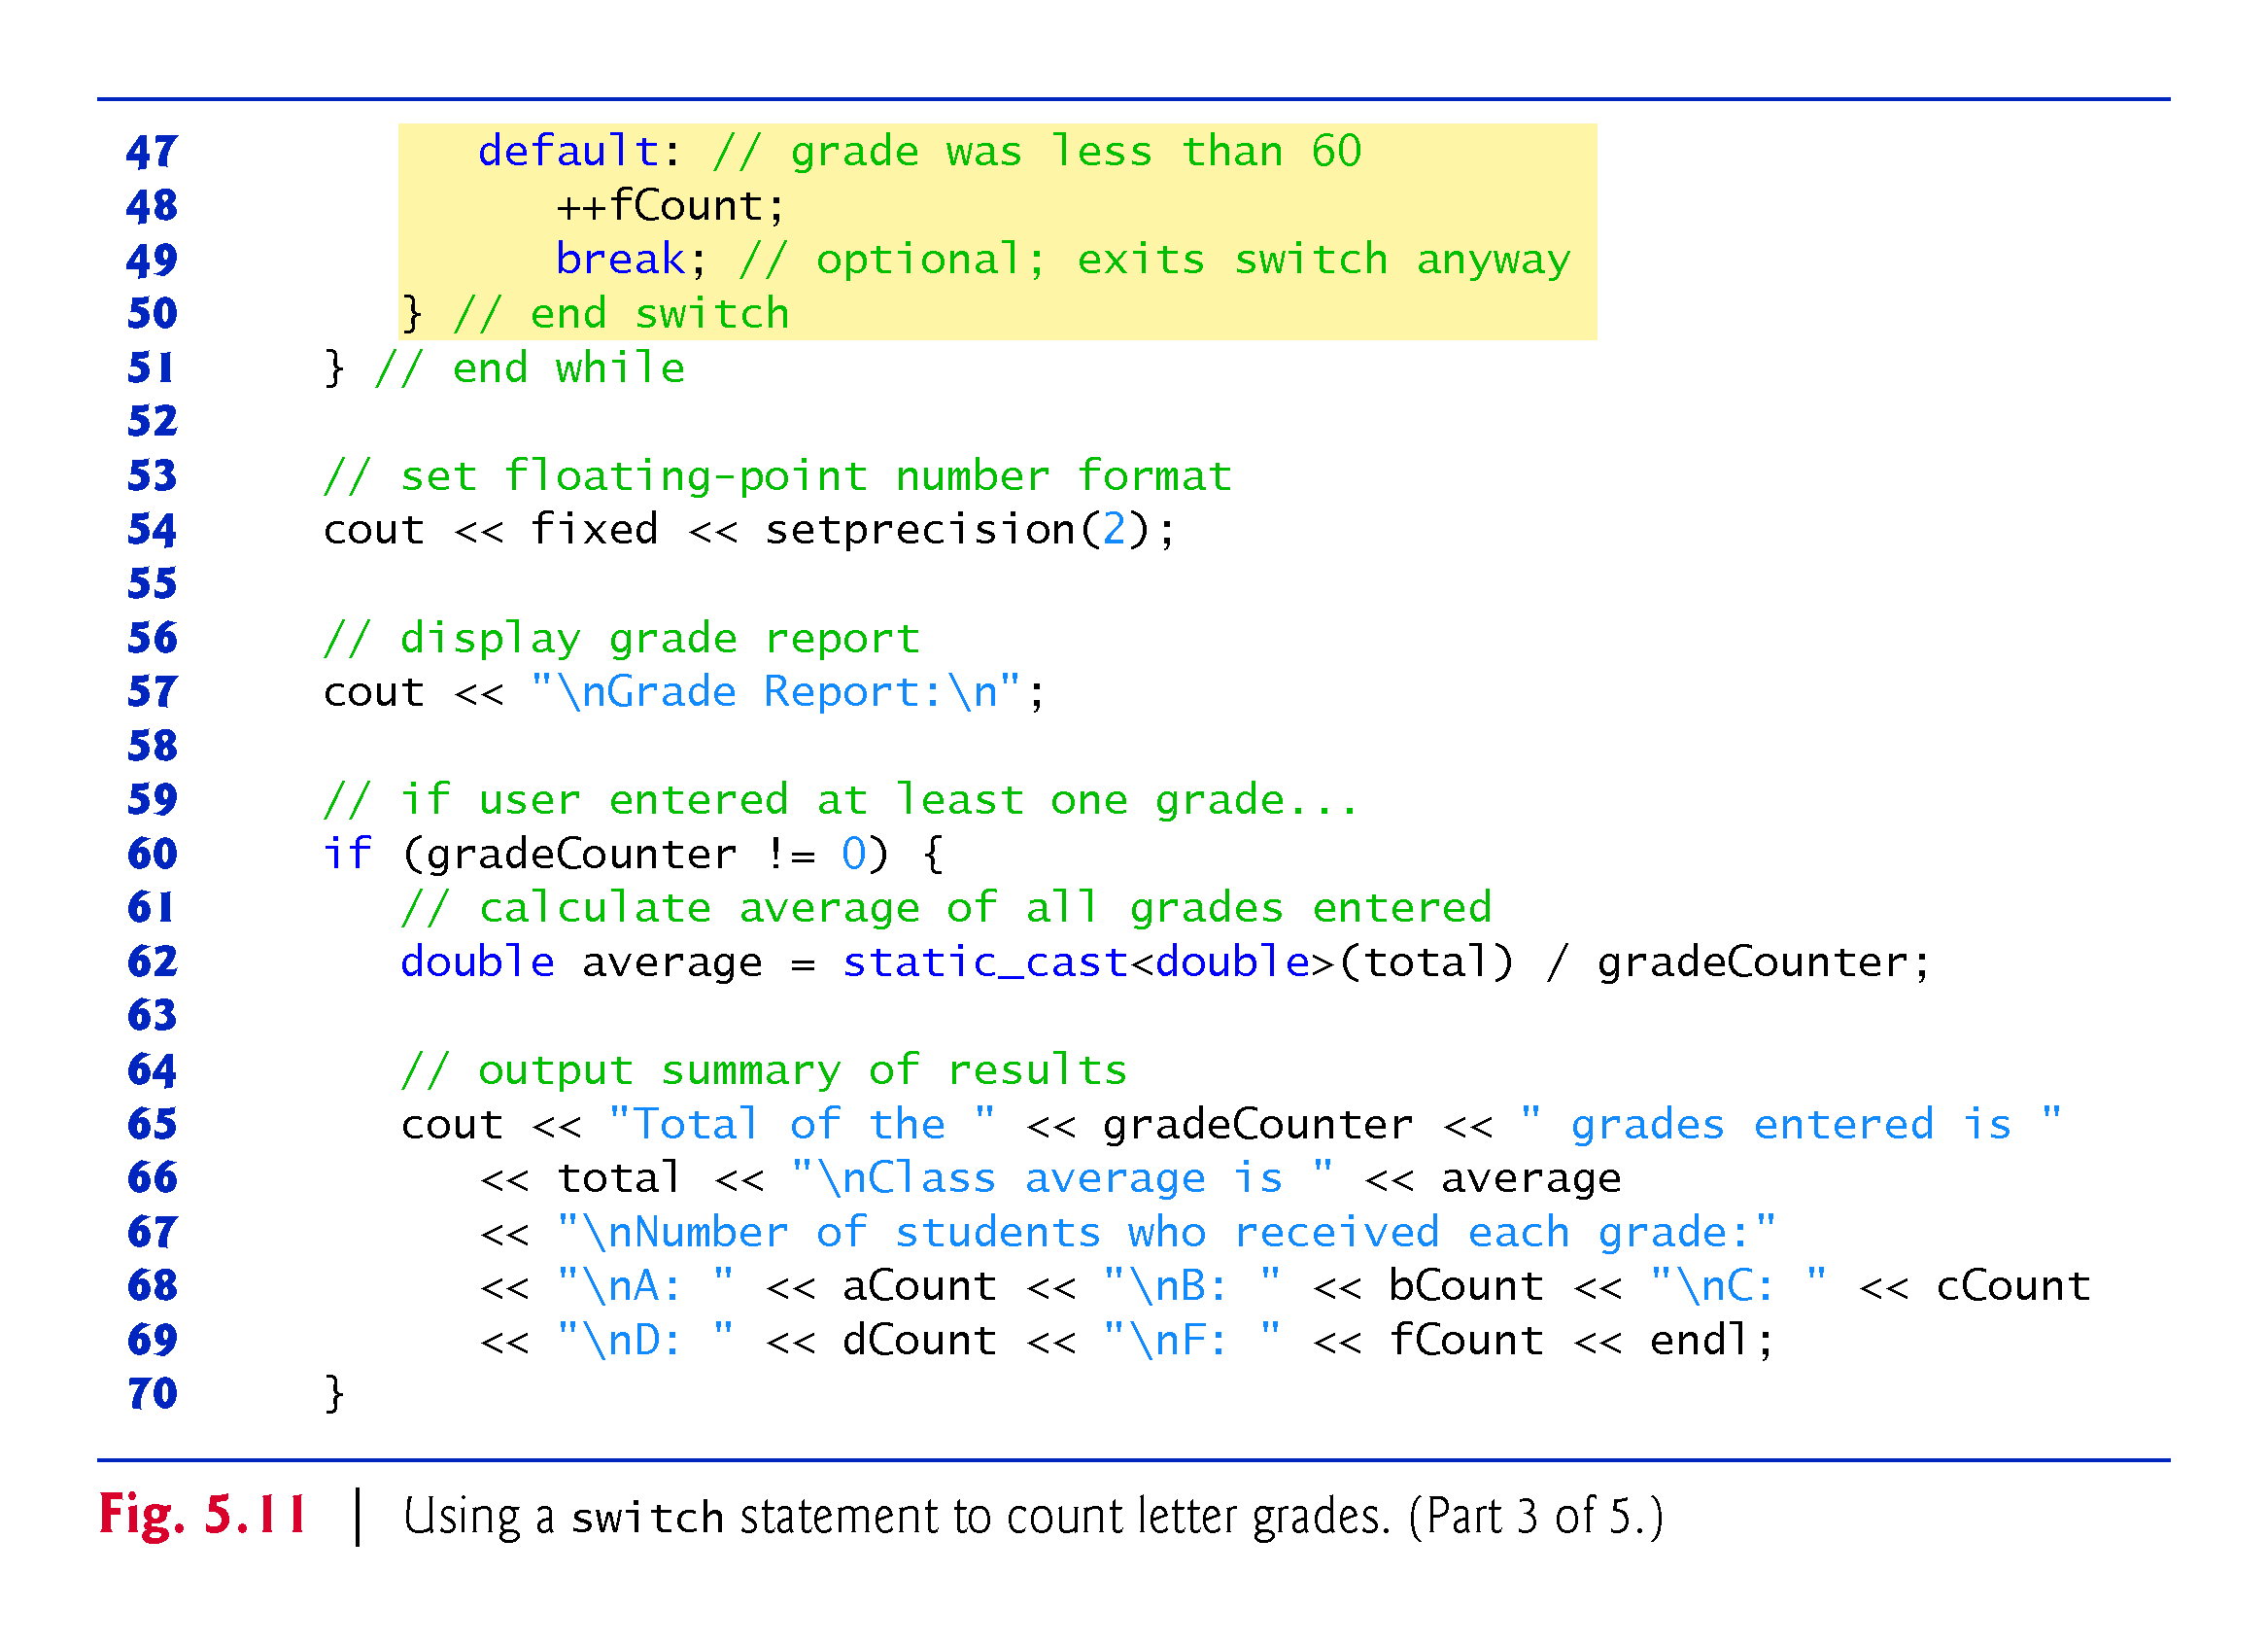

Slide 6
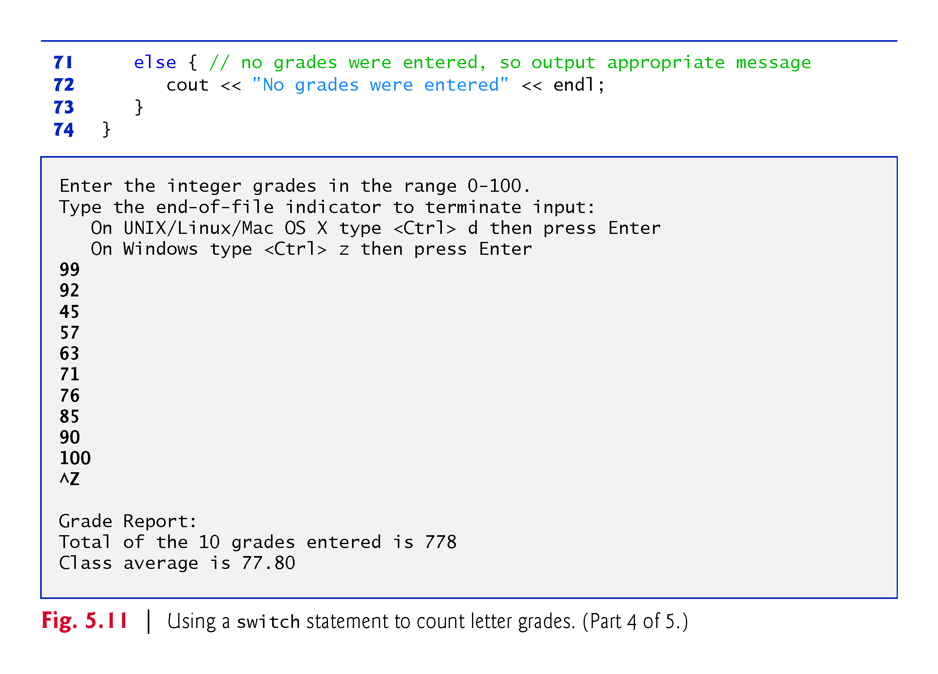

Slide 7
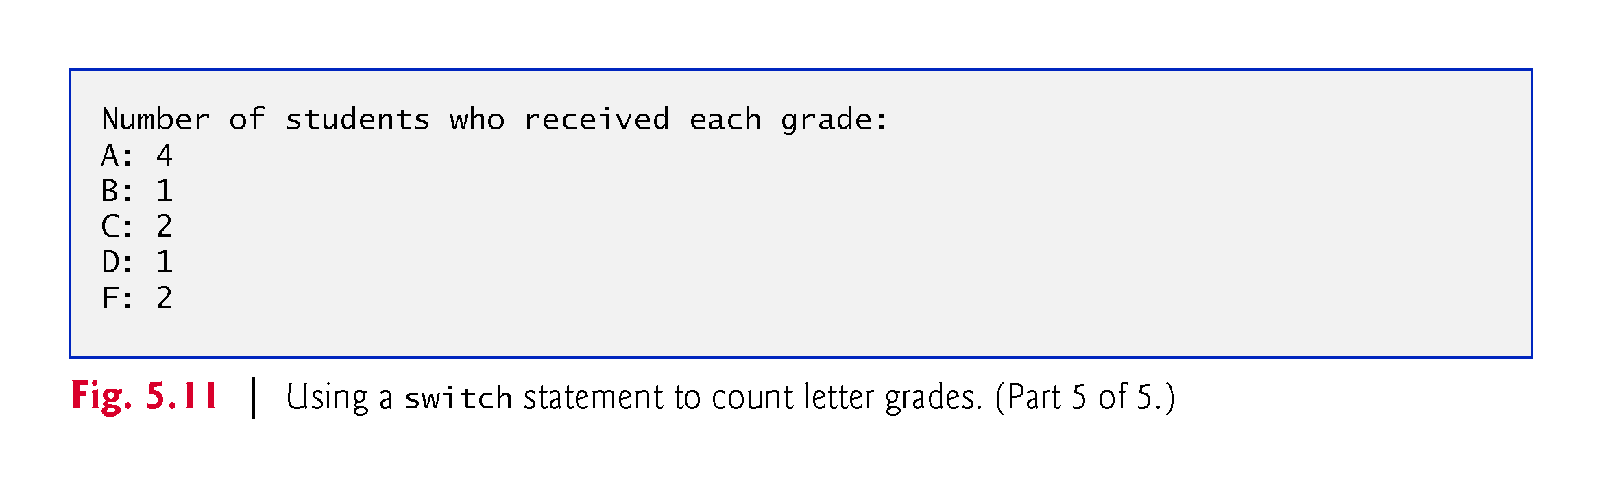

Slide 8
5.9 switch Multiple-Selection Statement (cont.)
Write a program that gives the day of the week. That is, 1 would be Monday, 2 Tuesday, … , 7 would be Sunday. It should ask for a number:
Input week number(1-7): 2 (for example)
and outputs the name of the day:
Tuesday
Write a program that asks for the number of the month and outputs the number of days in that month:
Input month number: 3 (for example)
Output: Total number of days = 31

Slide 9
5.9 switch Multiple-Selection Statement (cont.)
On UNIX/Linux/Mac OS X systems, end-of-file is entered by typing the following sequence on a line by itself
<Ctrl> d
This notation means to simultaneously press both the Ctrl key and the d key.
On Windows systems, end-of-file can be entered by typing
<Ctrl> z
Windows typically displays the characters ^Z on the screen in response to this key combination

Slide 10
5.9 switch Multiple-Selection Statement (cont.)
The switch statement consists of a series of case labels and an optional default case.
When the flow of control reaches the switch, the program evaluates the controlling expression in the parentheses.
Compares the value of the controlling expression with each case label.
If a match occurs, the program executes the statements for that case.
The break statement causes program control to proceed with the first statement after the switch.

Slide 11
5.9 switch Multiple-Selection Statement (cont.)
Listing cases consecutively with no statements between them enables the cases to perform the same set of statements.
Each case can have multiple statements.
The switch selection statement does not require braces around multiple statements in each case.
Without break statements, each time a match occurs in the switch, the statements for that case and subsequent cases execute until a break statement or the end of the switch is encountered.
Referred to as “falling through” to the statements in subsequent cases.

Slide 12
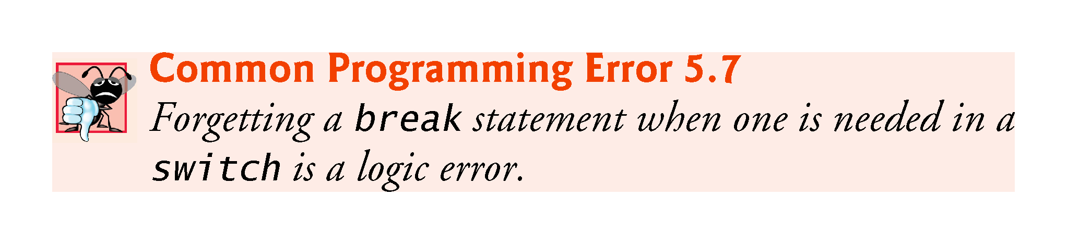

Slide 13
5.9 switch Multiple-Selection Statement (cont.)
If no match occurs between the controlling expression’s value and a case label, the default case executes.
If no match occurs in a switch statement that does not contain a default case, program control continues with the first statement after the switch.

Slide 14
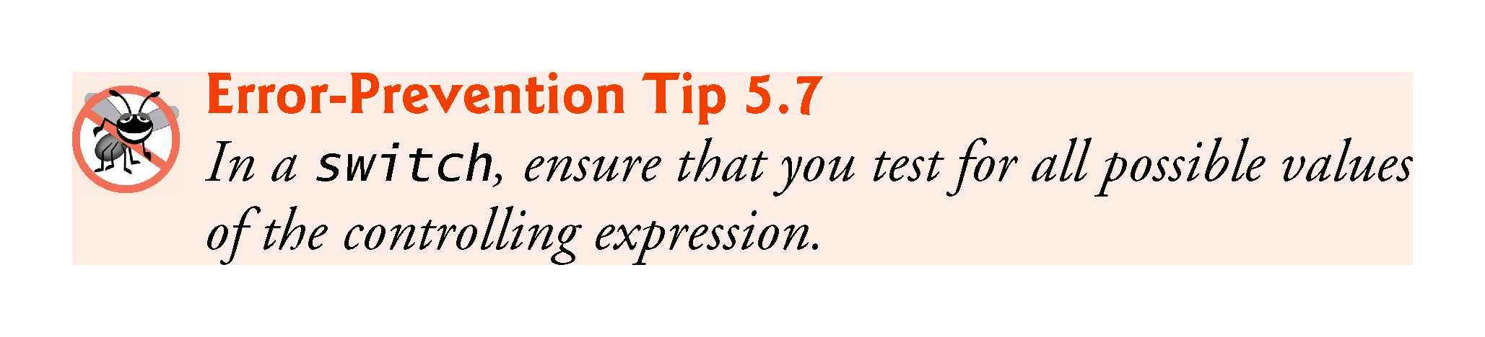

Slide 15
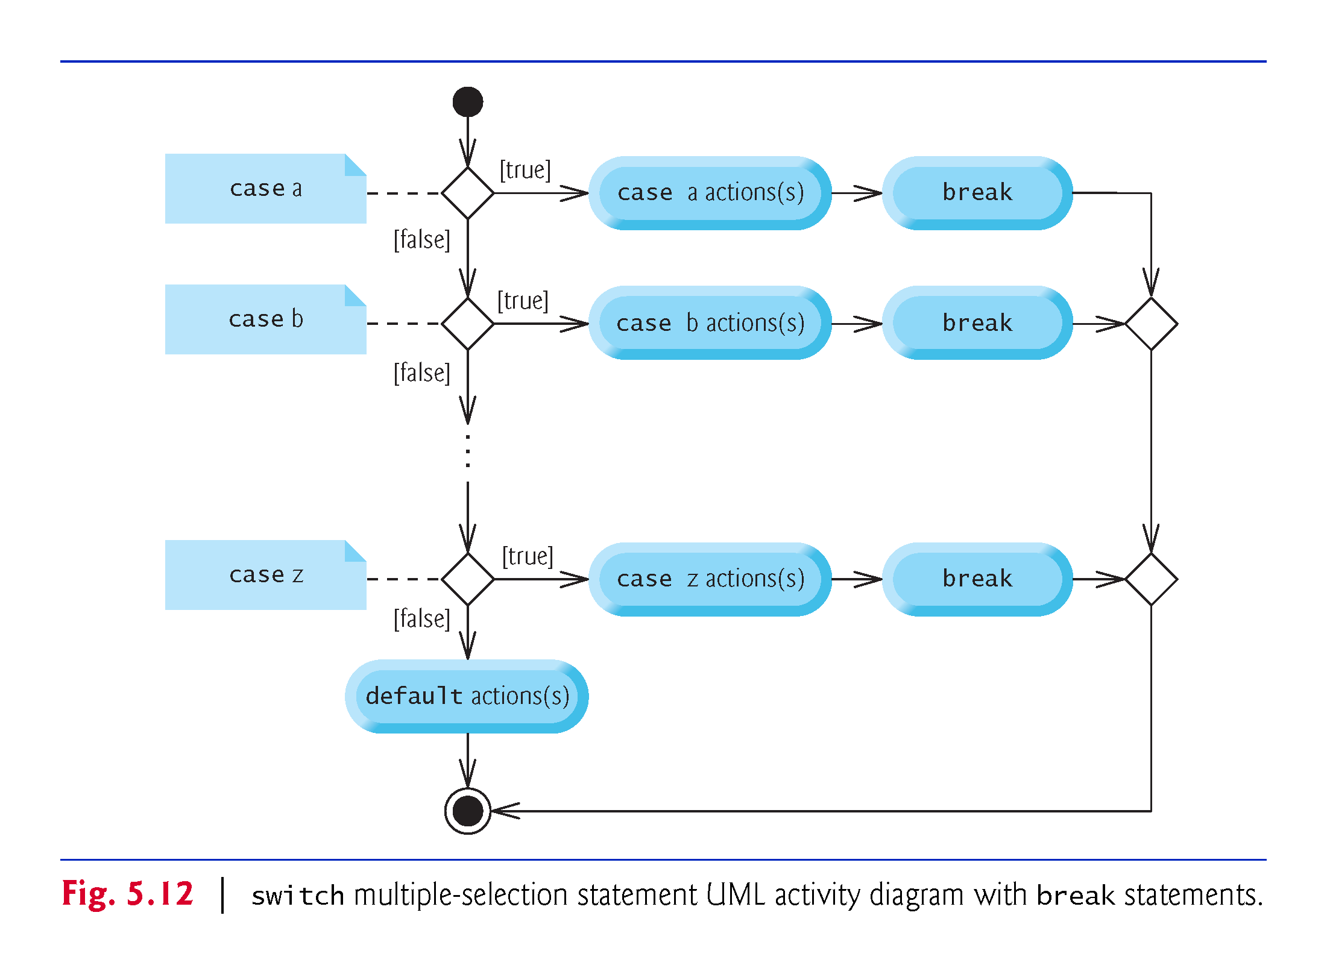

Slide 16
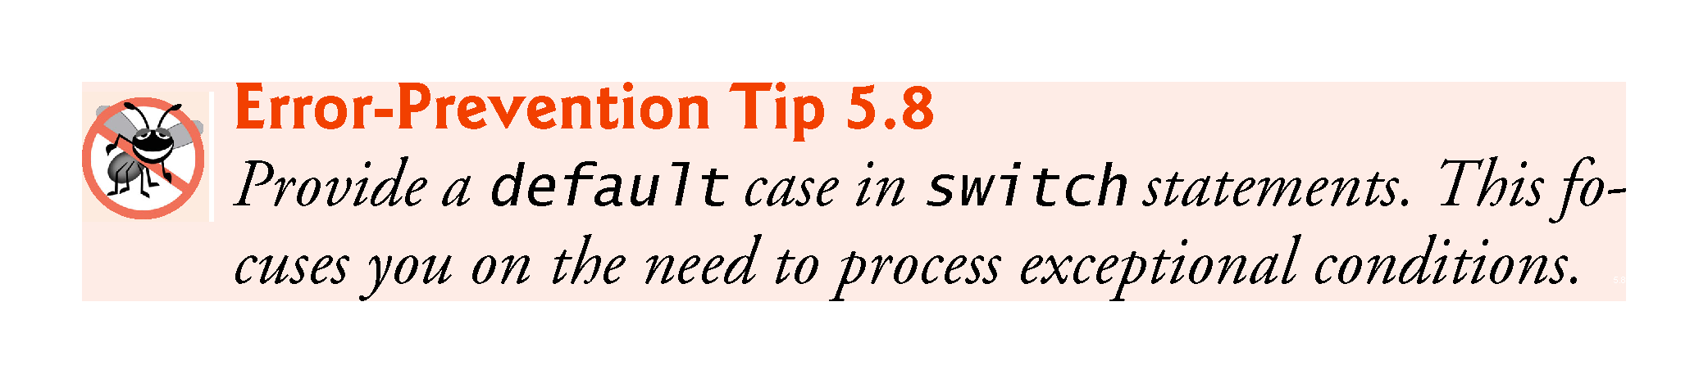

Slide 17
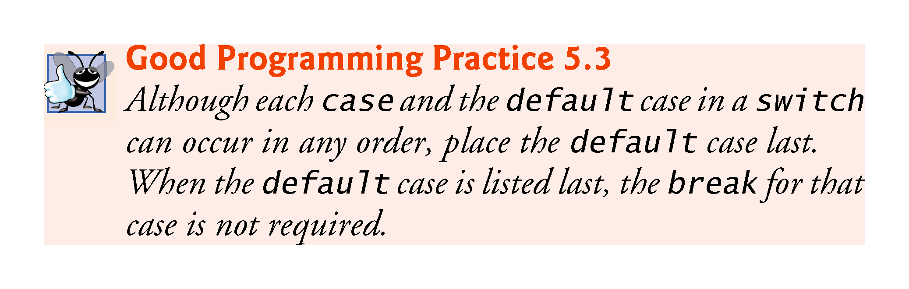

Slide 18
5.9 switch Multiple-Selection Statement (cont.)
case values
An integer constant is simply an integer value.
In addition, you can use character constants—specific characters in single quotes, such as 'A', '7' or '$'—which represent the integer values of characters and enum constants (introduced in Section 6.8). (Appendix B shows the integer values of the characters in the ASCII character set, which is a subset of the Unicode® character set.)
The expression in each case also can be a constant variable—a variable containing a value which does not change for the entire program.
Such a variable is declared with keyword const

Slide 19
5.10 break and continue Statements
In addition to selection and iteration statements, C++ provides statements break (which we discussed in the context of the switch statement) and continue to alter the flow of control.

Slide 20
5.10.1 break Statement
The break statement, when executed in a while, for, do…while or switch statement, causes immediate exit from that statement.
Program execution continues with the next statement.
Common uses of the break statement are to escape early from a loop or to skip the remainder of a switch statement.
Figure 5.13 demonstrates the break statement (line 13) exiting a for iteration statement.

Slide 21
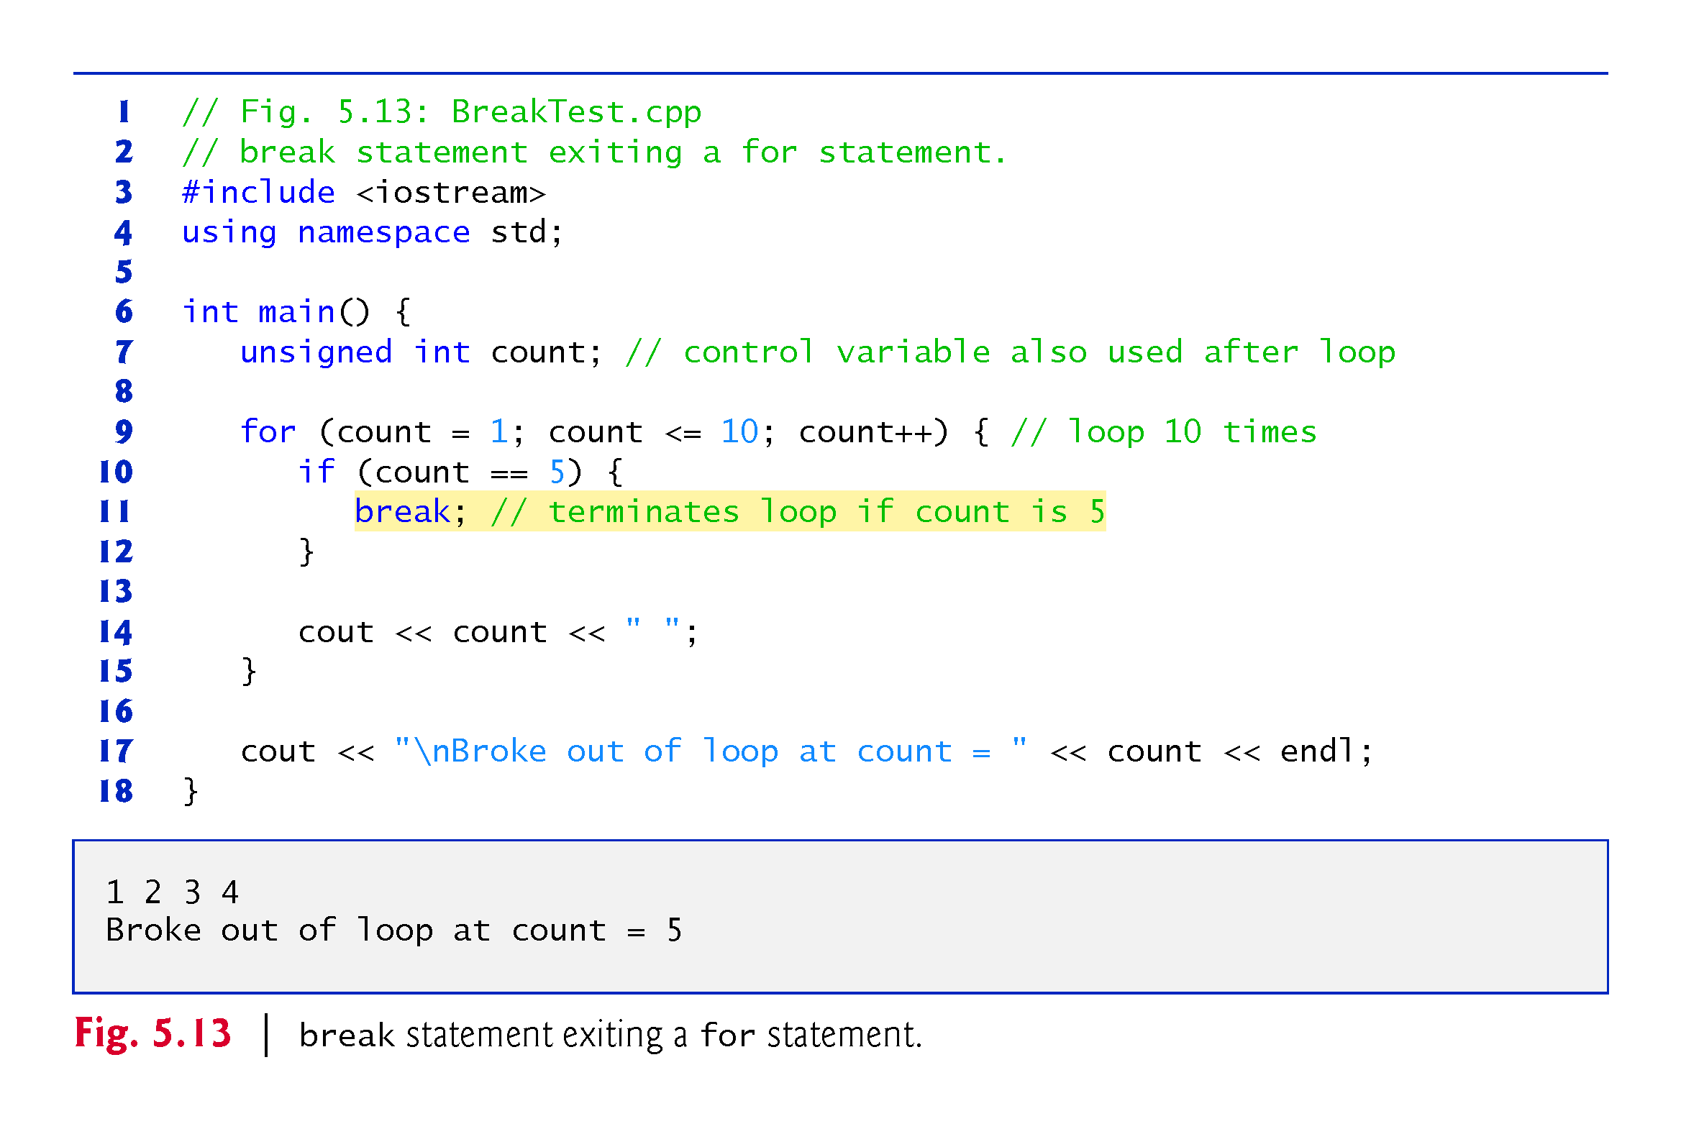

Slide 22
5.10.2 continue Statement
The continue statement, when executed in a while, for or do…while statement, skips the remaining statements in the body of that statement and proceeds with the next iteration of the loop.
In while and do…while statements, the loop-continuation test evaluates immediately after the continue statement executes.
In the for statement, the increment expression executes, then the loop-continuation test evaluates.

Slide 23
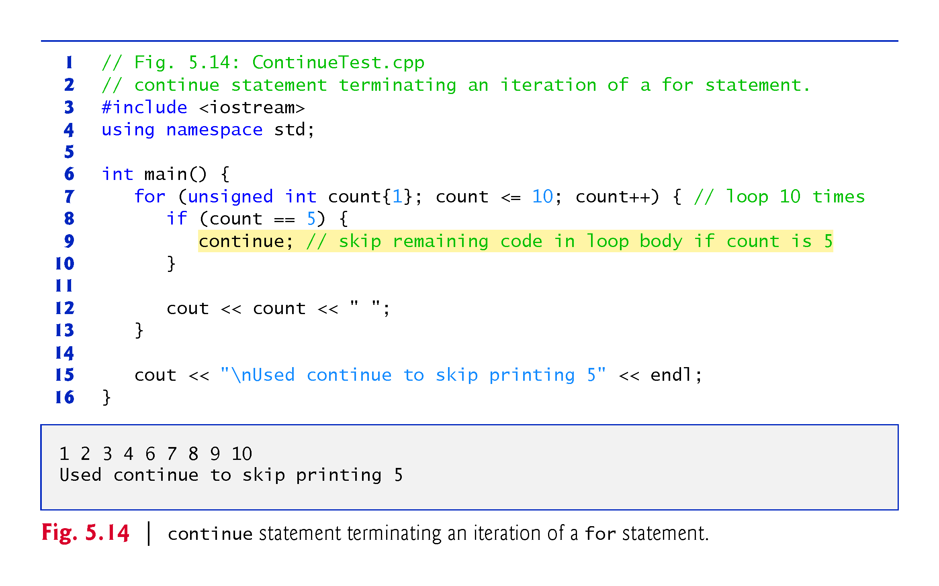

Slide 24
Continue and break exercises
Write a program that prints all the numbers from 1 to 20 but uses a while(true) (that is, an infinite loop) and uses a break when it reaches 20.
Modify the previous program using “continue” so that it skips 5 and 10.

Slide 25
5.11 Logical Operators
C++ provides logical operators that are used to form more complex conditions by combining simple conditions.
The logical operators are && (logical AND), || (logical OR) and ! (logical NOT, also called logical negation).

Slide 26
5.11.1 Logical AND (&&) Operator
The && (logical AND) operator is used to ensure that two conditions are both true before we choose a certain path of execution.
The simple condition to the left of the && operator evaluates first.
If necessary, the simple condition to the right of the && operator evaluates next.
The right side of a logical AND expression is evaluated only if the left side is true.

Slide 27
5.11.2 Logical OR (||) Operator
The || (logical OR) operator determines if either or both of two conditions are true before we choose a certain path of execution.
The && operator has a higher precedence than the || operator.
Both operators associate from left to right.

Slide 28
5.11.4 Logical Negation (!) Operator
The ! (logical negation, also called logical NOT or logical complement) operator “reverses” the meaning of a condition.
Unlike the logical operators && and ||, which are binary operators that combine two conditions, the logical negation operator is a unary operator that has only one condition as an operand.

Slide 29
5.11.5 Logical Operators Example
Figure 5.18 demonstrates the logical operators by producing their truth tables.
The output shows each expression that is evaluated and its bool result.
By default, bool values true and false are displayed by cout and the stream insertion operator as 1 and 0, respectively.
Stream manipulator boolalpha (a sticky manipulator) specifies that the value of each bool expression should be displayed as either the word “true” or the word “false.”

Slide 30
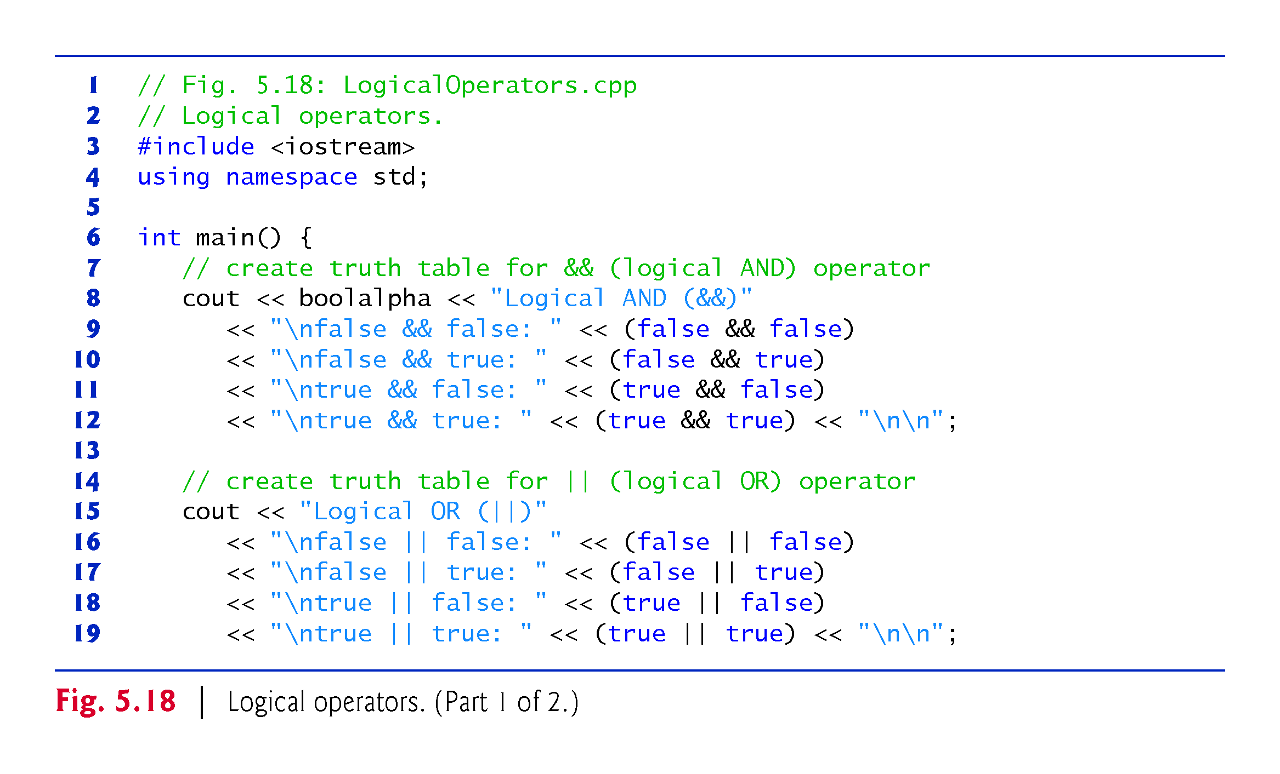

Slide 31
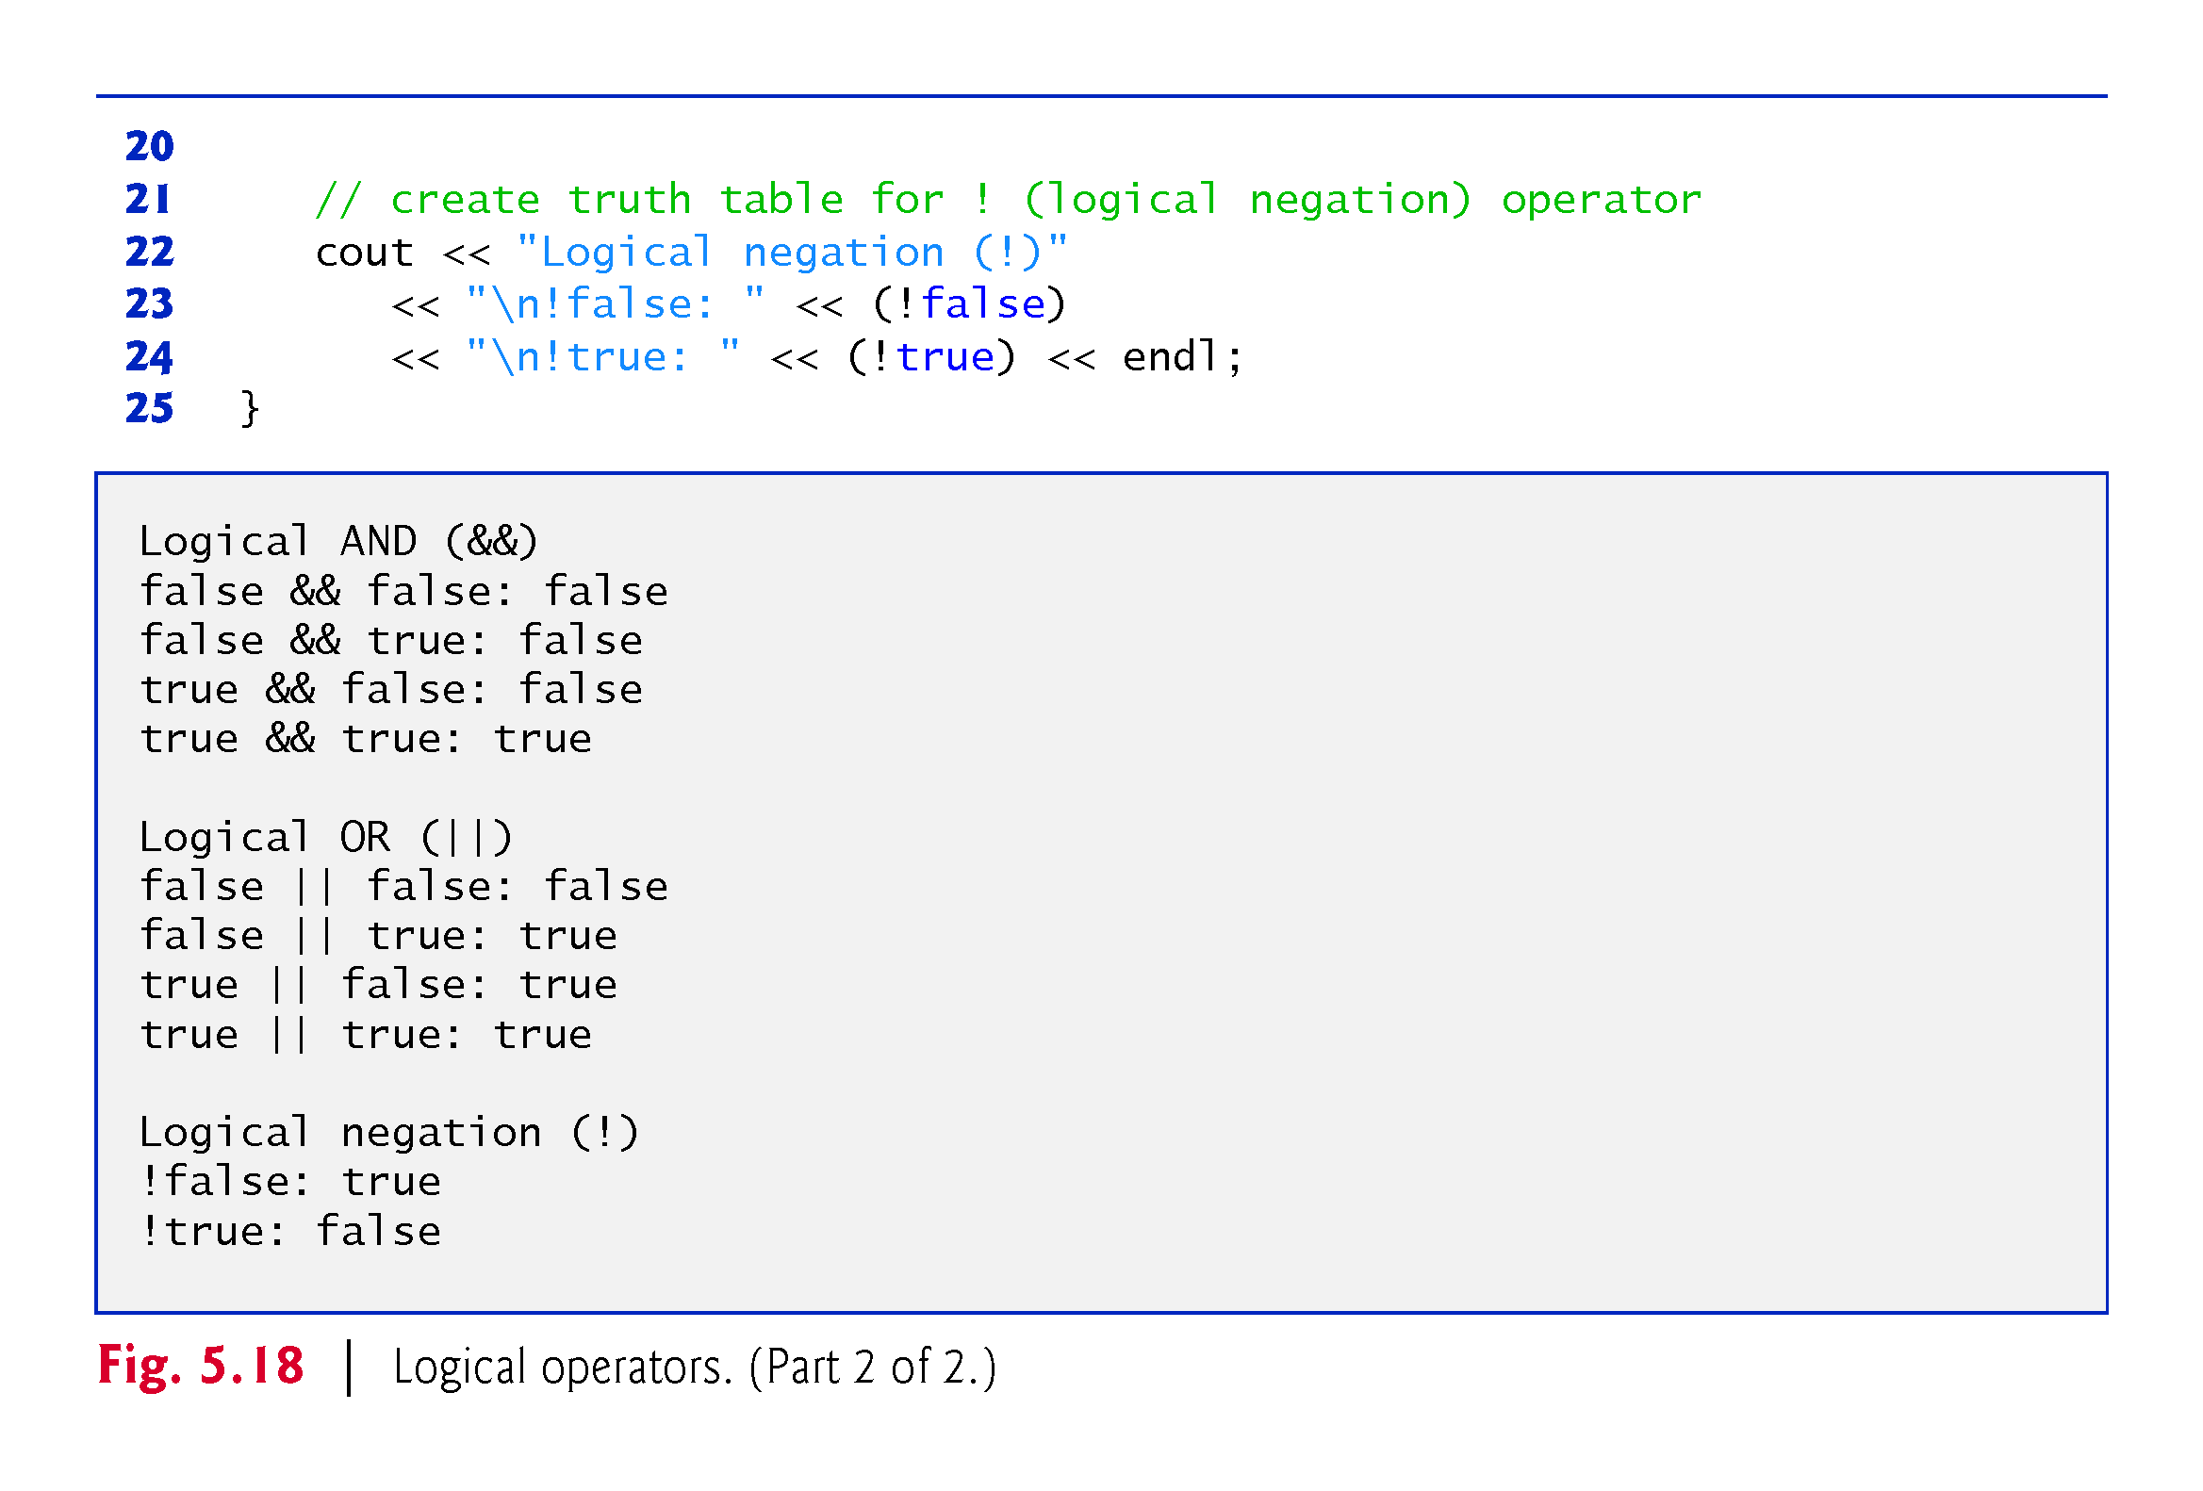

Slide 32
5.11.5 Logical Operators (cont.)
Figure 5.19 adds the logical and comma operators to the operator precedence and associativity chart.
The operators are shown from top to bottom, in decreasing order of precedence.

Slide 33
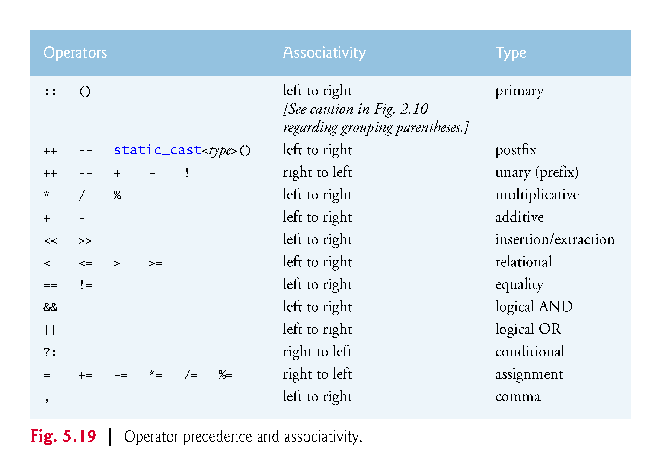

Slide 34
5.12 Confusing the Equality (==) and Assignment (=) Operators
Accidentally swapping the operators == (equality) and = (assignment).
Damaging because they ordinarily do not cause syntax errors.
Rather, statements with these errors tend to compile correctly and the programs run to completion, often generating incorrect results through runtime logic errors.
Any nonzero value is interpreted as true.

Slide 35
5.12 Confusing the Equality (==) and Assignment (=) Operators (cont.)
Variable names are said to be lvalues (for “left values”) because they can be used on the left side of an assignment operator.
Constants are said to be rvalues (for “right values”) because they can be used on only the right side of an assignment operator.
Lvalues can also be used as rvalues, but not vice versa.

Slide 36
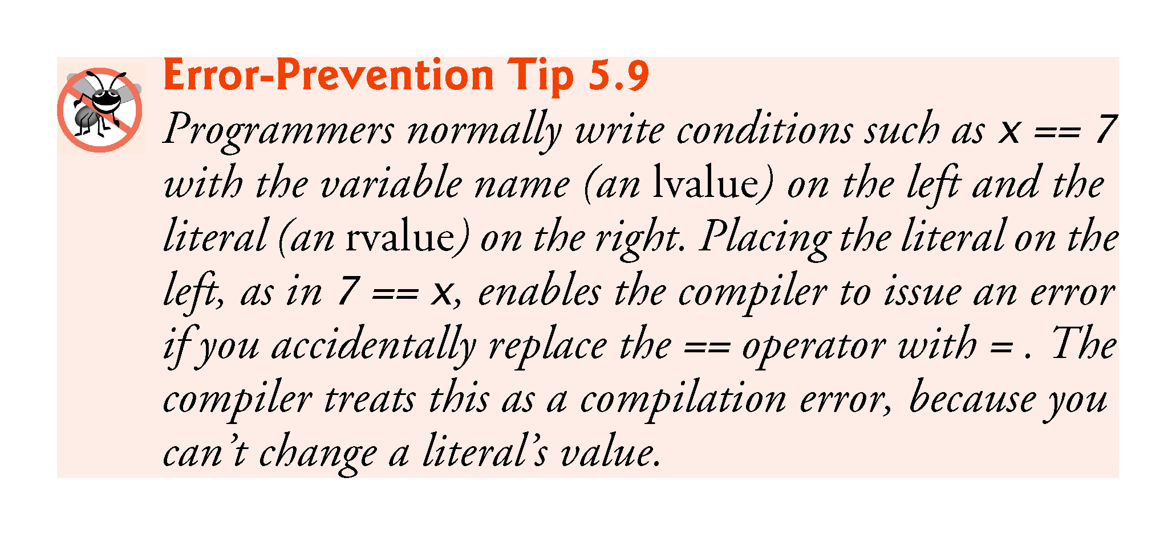

Slide 37
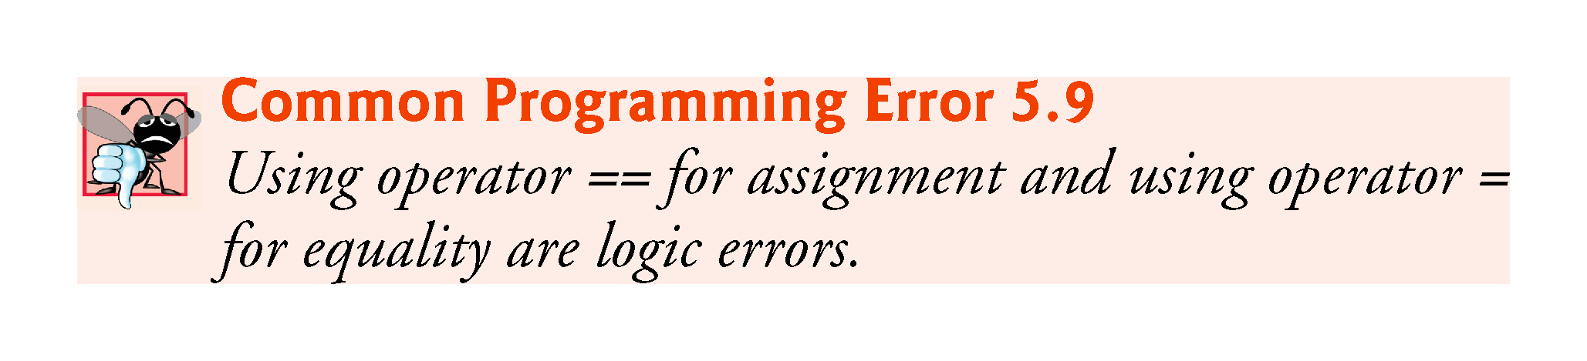

Slide 38
5.13 Structured Programming Summary
We’ve learned that structured programming produces programs that are easier than unstructured programs to understand, test, debug, modify, and even prove correct in a mathematical sense.
Figure 5.20 uses activity diagrams to summarize C++’s control statements.
The initial and final states indicate the single entry point and the single exit point of each control statement.

Slide 39
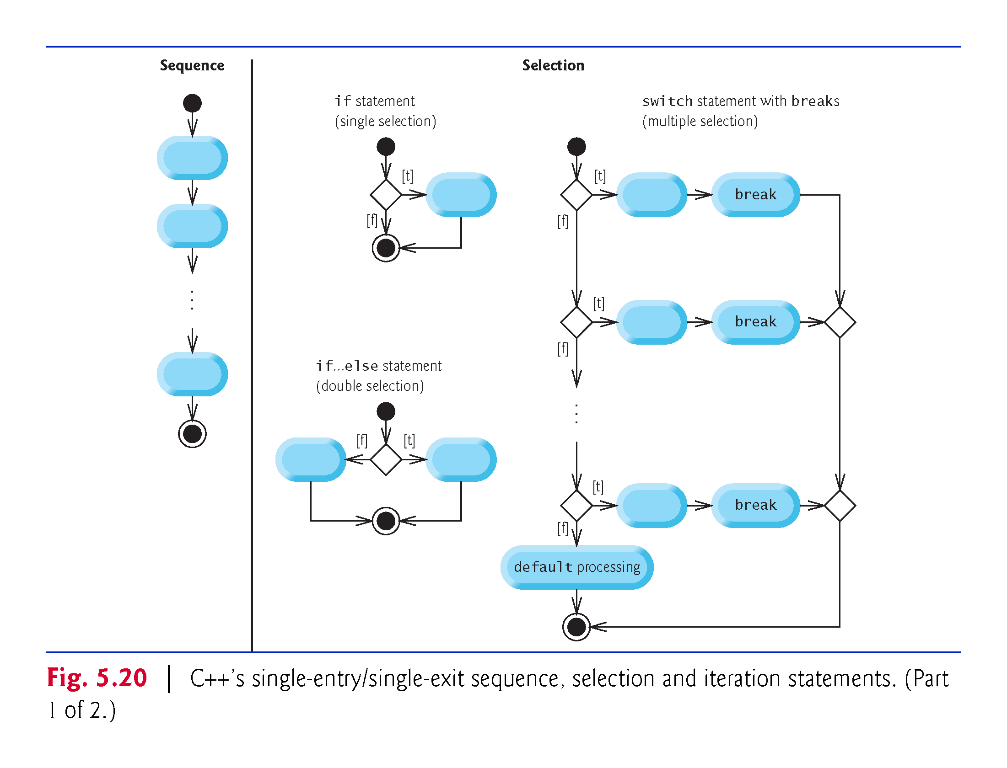

Slide 40
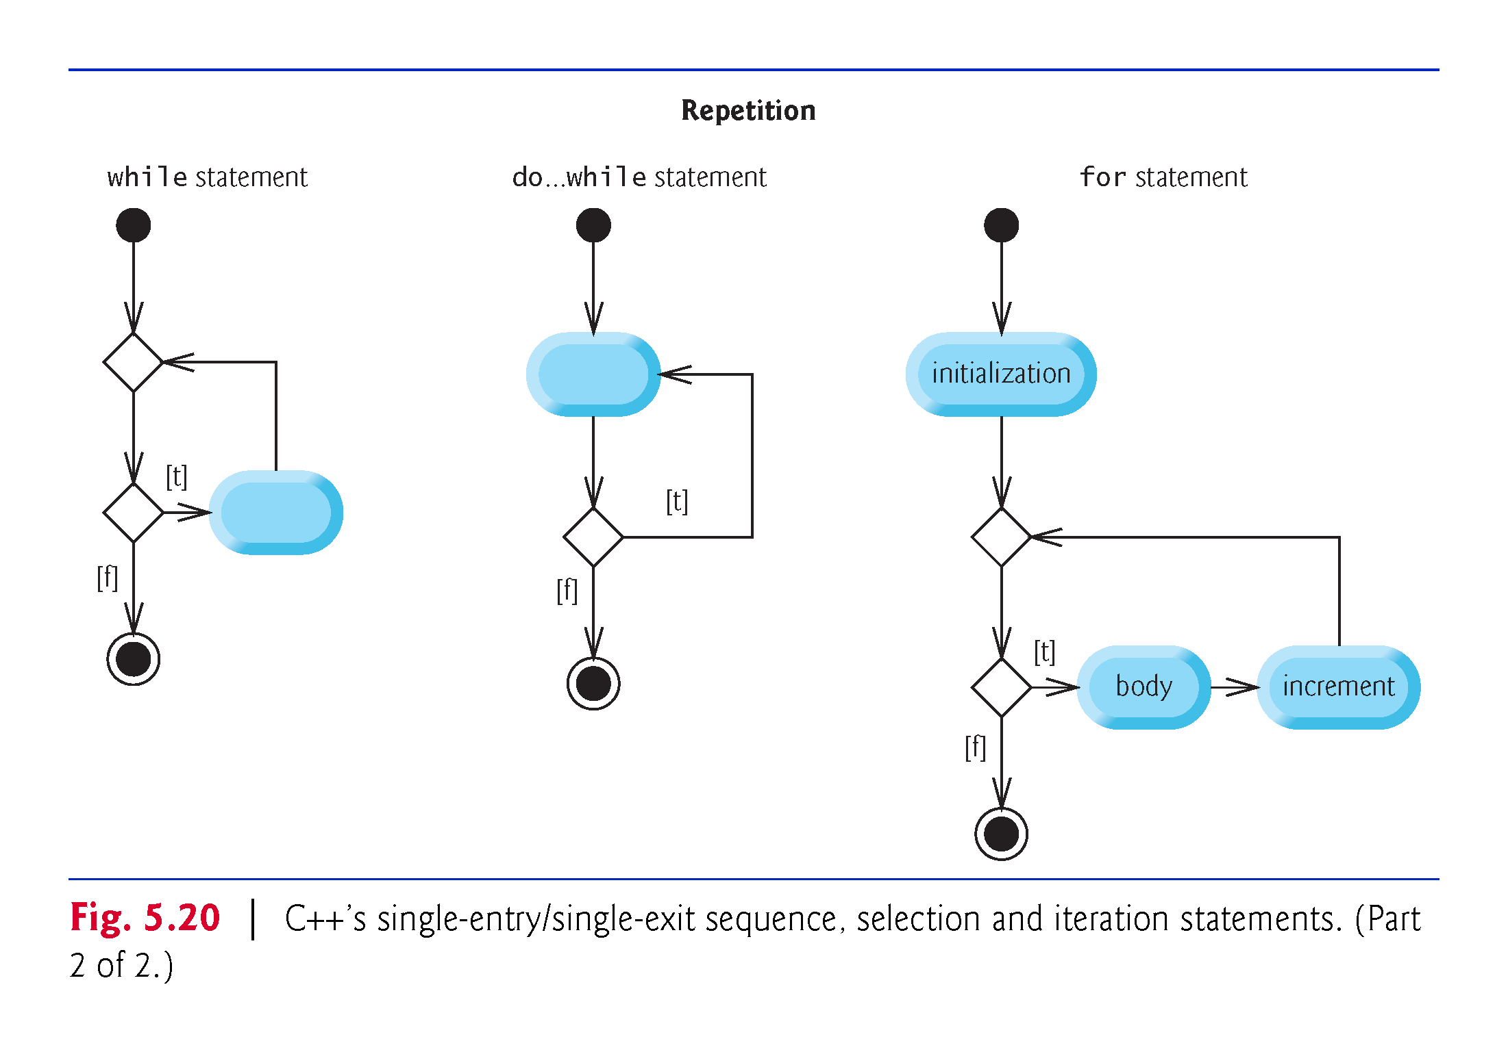

Slide 41
5.13 Structured Programming Summary (cont.)
Figure 5.21 shows the rules for forming structured programs.
The rules assume that action states may be used to indicate any action.
The rules also assume that we begin with the so-called simplest activity diagram (Fig. 5.22), consisting of only an initial state, an action state, a final state and transition arrows.
Applying the rules of Fig. 5.21 always results in an activity diagram with a neat, building-block appearance.
Rule 2 generates a stack of control statements, so let’s call Rule 2 the stacking rule.
Rule 3 is the nesting rule.

Slide 42
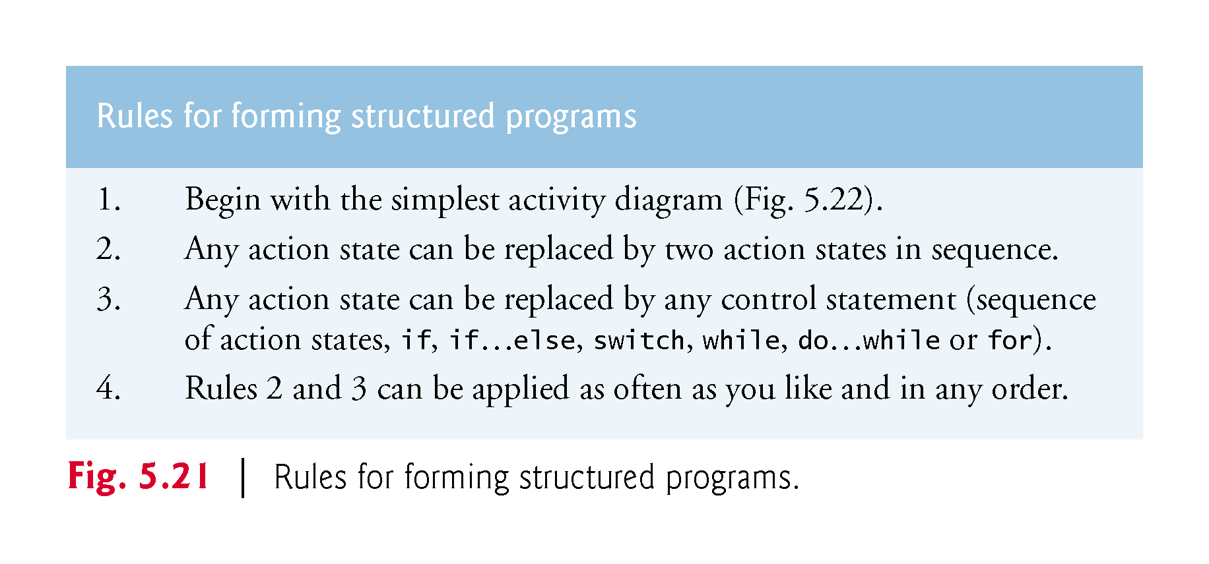

Slide 43
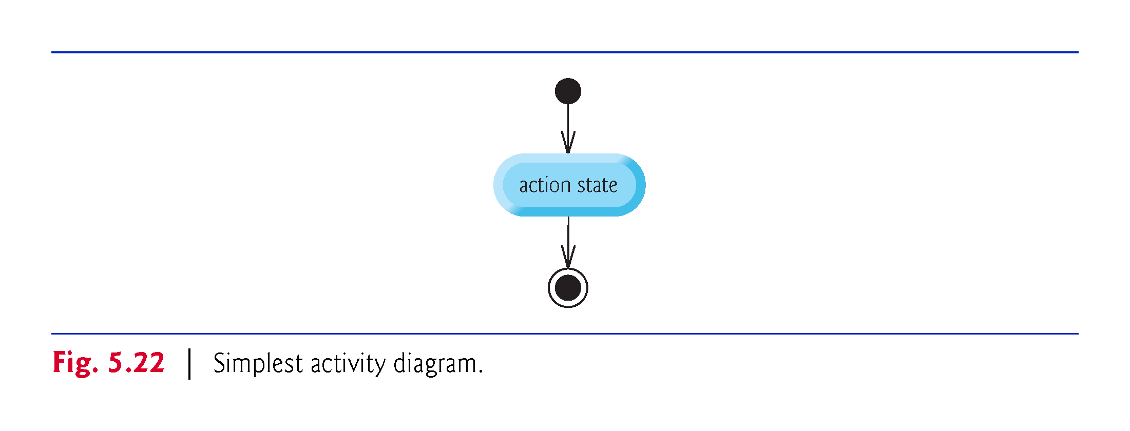

Slide 44
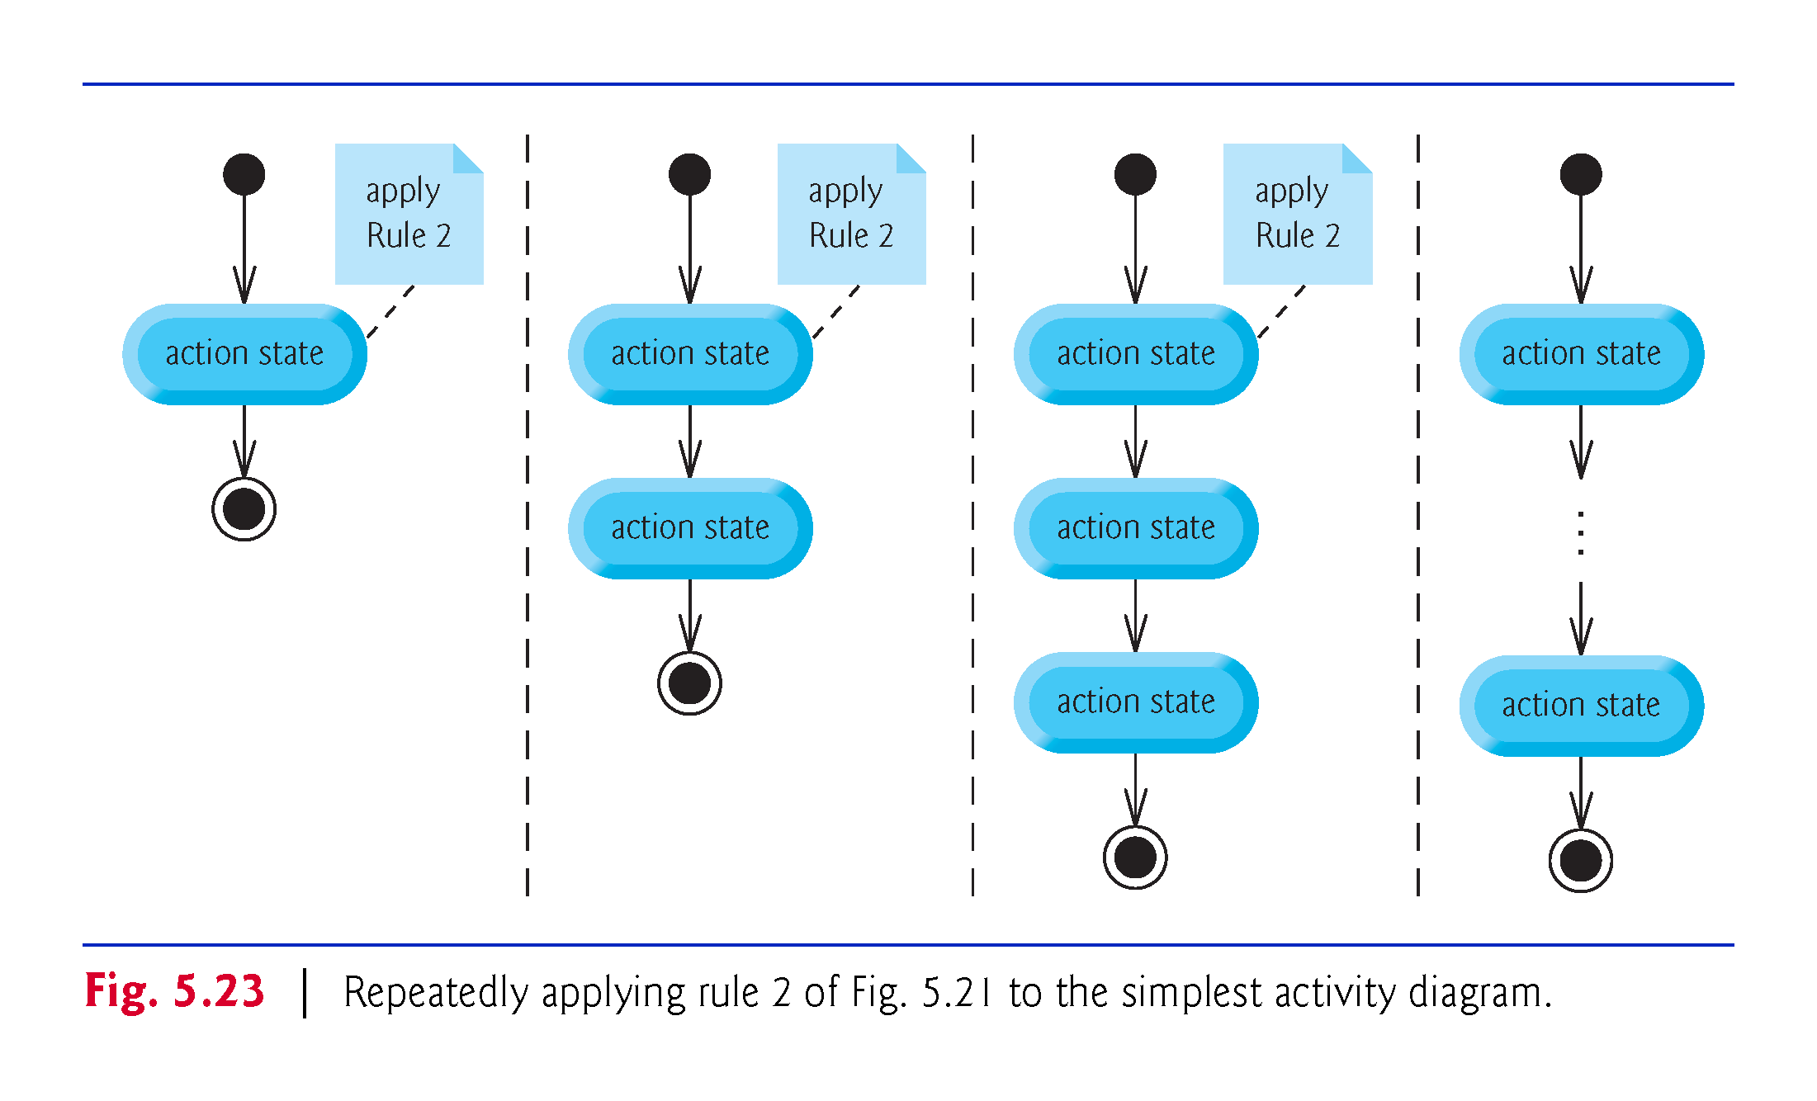

Slide 45
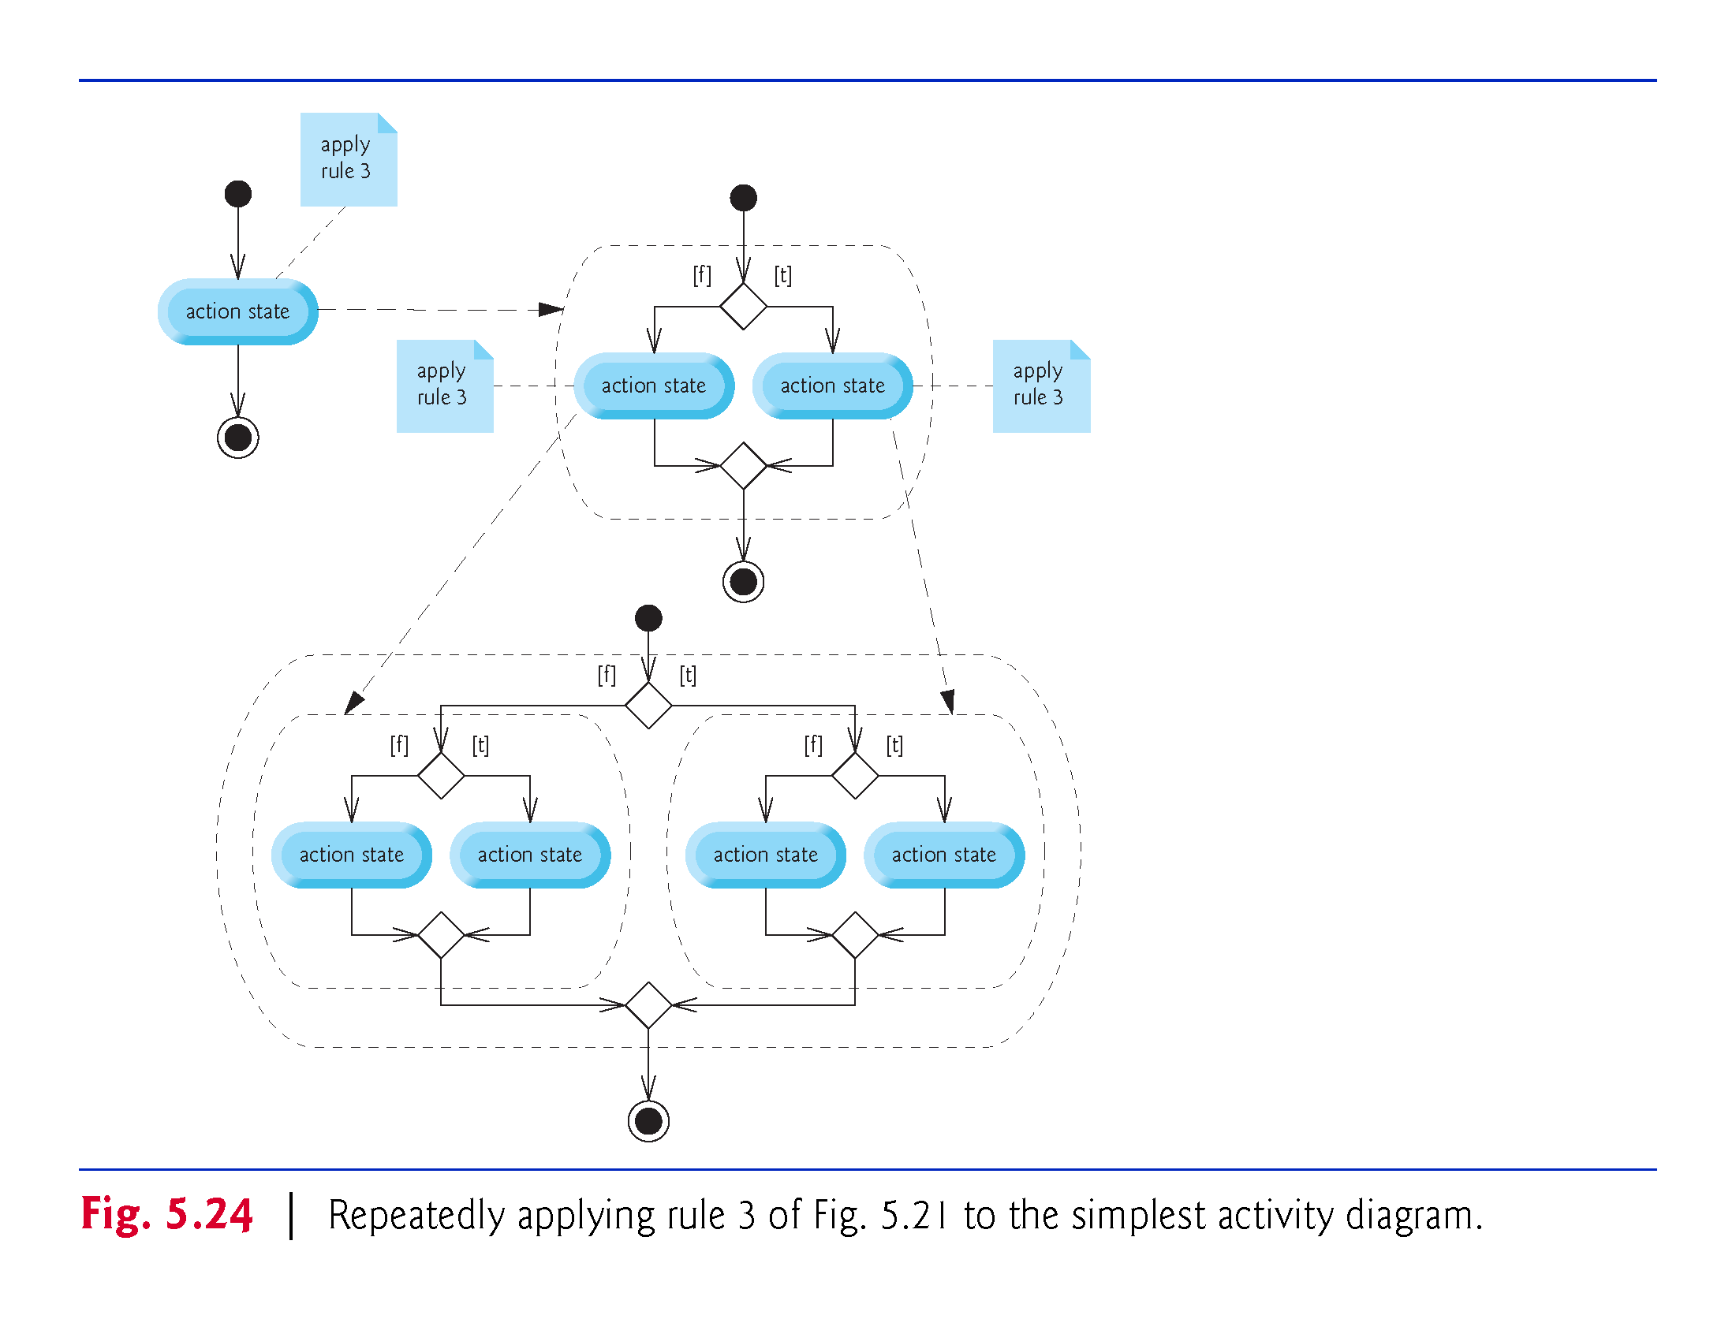

Slide 46
